Slide 1

Predictive Model for English Premier League Match Outcomes
Football
Based on Team Historical Performance and Offensive/Defensive Data
DSCI-510 Final Project Frank Wu

Slide 2
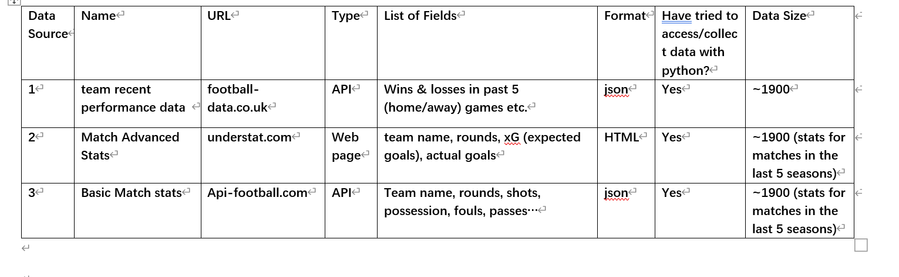
Data Sources

Slide 3
Methods
XGBoost (eXtreme Gradient Boosting)
A kind of Gradient Boosting Decision Tree (GBDT)
Performs well in tabular data
Handling missing data
Regularization to prevent overfitting for smaller datasets
Feature importance function
Notes:
GBDT: a classic and powerful machine learning algorithm, based on decision trees and gradient boosting.
Gradient Boosting: builds the model step-by-step to correct errors.

Slide 4
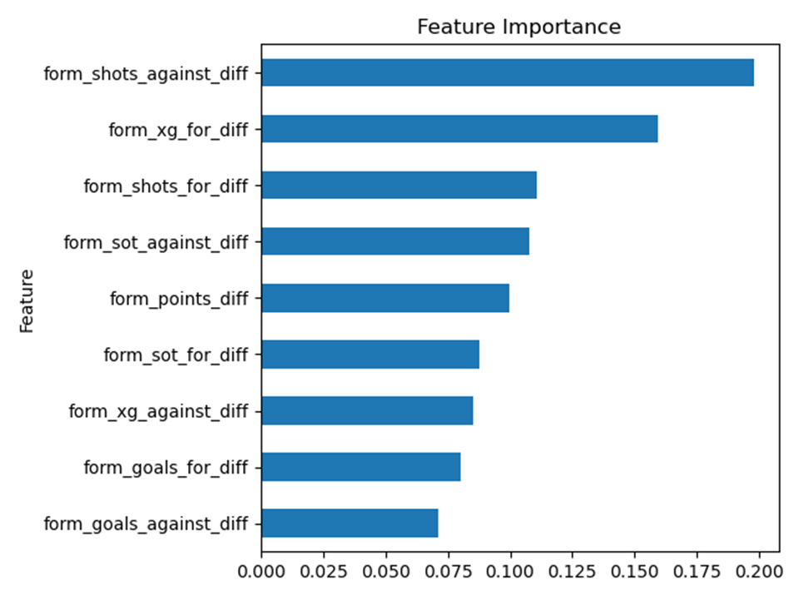
Results

Slide 5
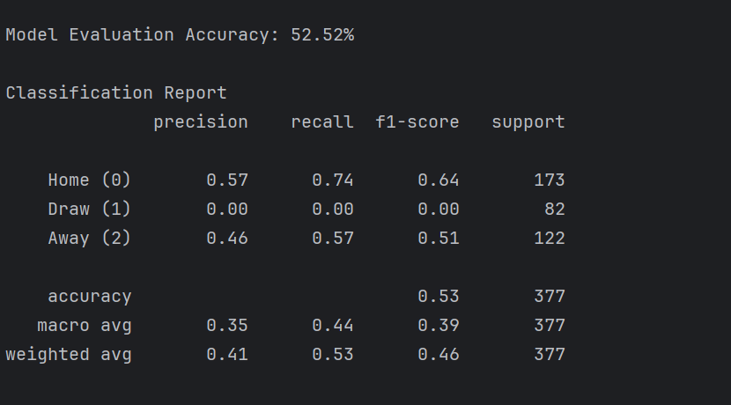
Results

Slide 6

…but

Slide 7
Potential Improvements
xG (expected goals)
ELO system?

Slide 8
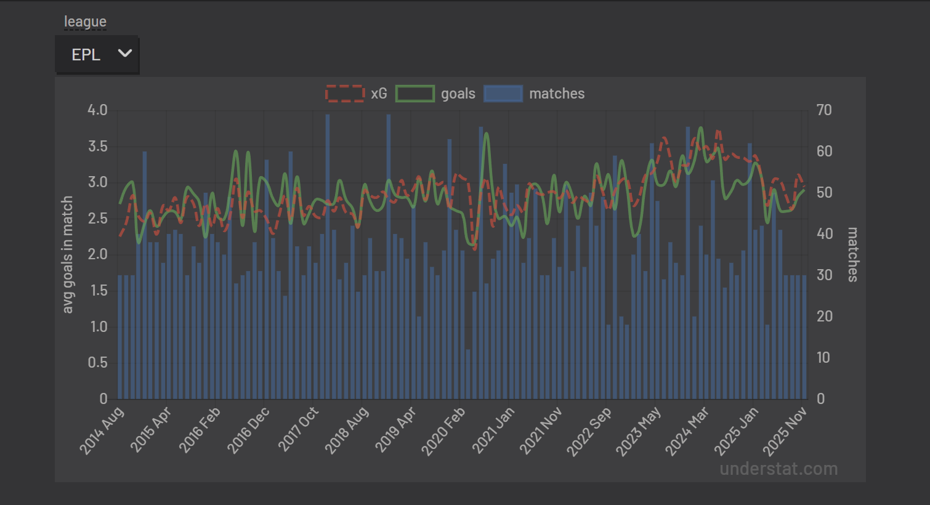

Slide 9
THANKS

